Slide 1
Lesson 6: aligning on Walls & MODELS
Seshan brothers

Slide 2
WHY Align on walls & MODELS
Aligning on walls and mission models can help your robot straighten out along its path
After traveling from base and turning, the robot may no longer be straight
Backing into the wall will help the robot straighten out
Align on the Wall
Align on the Model
Align on the Wall

Slide 3
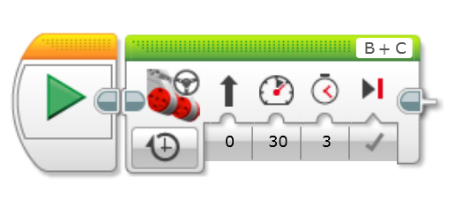
Moving for seconds
To align on the wall or a fixed mission model, you will use Move Seconds
Why use Move Seconds?
If Move Degrees or Rotations is used and the robot hits the wall before the move is completed the robot will stall because it will keep trying to move.
With Move Seconds, the robot will continue on with the program after a specified number of seconds no matter how far it went.

Slide 4
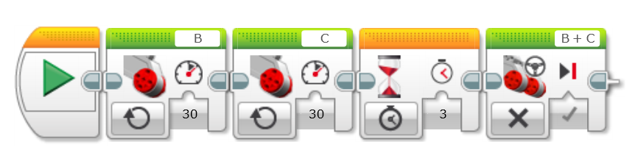
How to program
To make the program, two separate motor blocks (one for the left motor and one for the right motor) will be needed. The robot will wait for seconds and then turn off the motors.
Why not use one Move Steering block like on the previous page?
In the Move Steering block, motors are synchronized so when one wheel hits the wall and stops, the other wheel will stop as well even if it hasn’t touched the wall yet. Therefore, the robot will not be straight.

Slide 5
NEXT Steps
Take a look at the Stall Detection and Move Blocks lesson on EV3Lessons.com for more tips.
Think about how you would apply this lessons to INTO ORBIT
Are there alternative strategies you can use to align on a mission model or wall? E.g. using a touch sensor or stall detection techniques

Slide 6

Credits
This tutorial was created by Sanjay Seshan and Arvind Seshan
More lessons at www.ev3lessons.com and www.flltutorials.com
This work is licensed under a Creative Commons Attribution-NonCommercial-ShareAlike 4.0 International License.

